Slide 1
Lived experience in living guidelines: Recruiting for diversity
Dr Anneliese Synnot, Senior Research Fellow, Australian Living Evidence Collaboration, Monash University
Alecia Staines, Founder & Director, Maternity Consumer Network
Evidence Synthesis Ireland webinar, 19 September 2024

Slide 2
Declarations
The LEAPP Project is funded by the Australian Department of Health and Aged Care.
Terminology
Consumers = patients and the public
Consumer engagement = PPI

Slide 3
About the LEAPP guidelines
Five-year living guideline development program (2023 – 2028)
To develop and maintain Australian national pregnancy and postnatal care guidelines
Partnership led by:
Australian Living Evidence Collaboration (ALEC, Monash)
Australian College of Midwives
Royal Australian and New Zealand College of Obstetricians and Gynaecologists
24 member organisations (including Maternity Consumer Network)

Slide 4
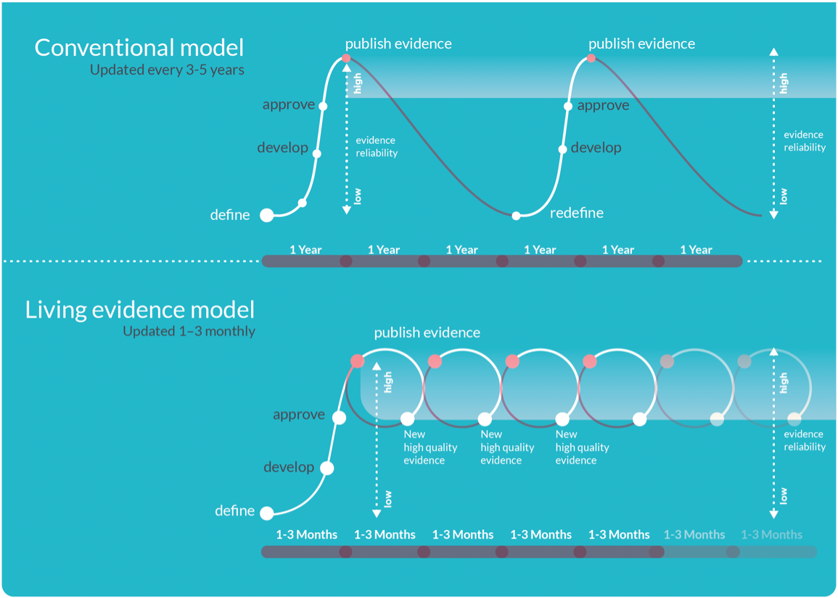
Living guidelines
Living guidelines retain the core guideline development steps
They involve continual evidence searches and rapid updates to recommendations

Slide 5
Leading maternity consumer organization (>1100 members and member organisations) High socials engagement- Instagram and facebook Education- training for staff, rights Advocacy- improving maternity services for women Advisory- government and various consumer reps
Advocacy
Advisory
Education

Slide 6
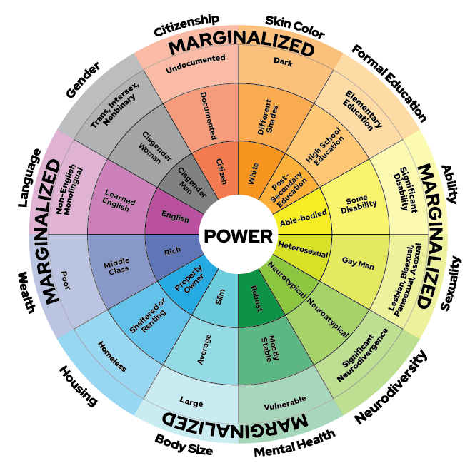
Health equity
Guideline recommendations are not always universally applicable across populations and patient groups.
They may unintentionally result in poorer health outcomes for people from marginalised groups.
https://kb.wisc.edu/instructional-resources/page.php?id=119380
Health inequities = differences in people’s health that are unnecessary, avoidable, unfair and unjust.
Dans 2007 J Clin Epi
Eslava-Schmalbach 2011 Rev Salud Publica
Whitehead 1992 Int J Health Serv

Slide 7
Addressing health equity in guidelines
Guideline developers may address equity in different ways
One approach is to directly engage consumers from diverse backgrounds in the guideline development process.
But recruiting and engaging diverse groups is commonly described as a challenge/limitation by guideline developers who have undertaken consumer engagement activities.
Akl 2007 J Clin Epi
Synnot 2022 BMJ Open

Slide 8
Organisational partnerships
Co-design the engagement
Tailored recruitment via partner organisations
Provide clear expectations and offer additional training and support
Guideline personnel are skilled and culturally sensitive
Include more people / consumer-only activities (creates safe spaces)
Reduce barriers to involvement (e.g. offer payment, flexible methods)

Slide 9
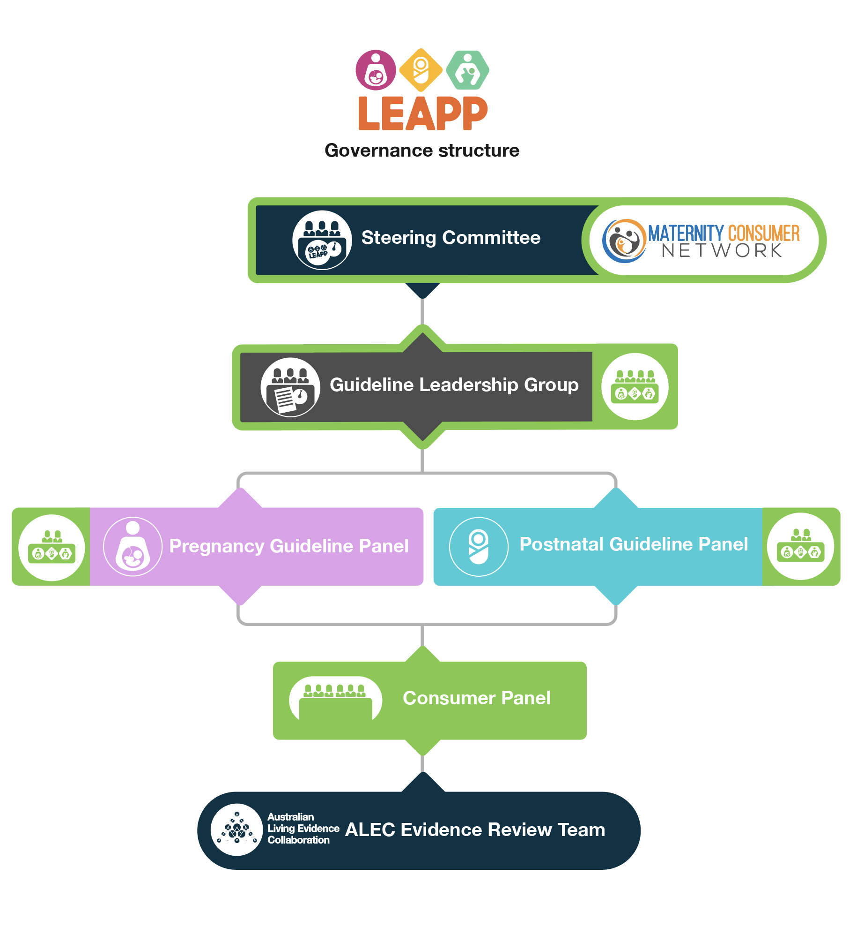
How consumers are involved
Steering Committee
1 Consumer organisation represented
Clinical Panels and Guideline Leadership Group
2 or 4 Consumer Co-Chairs are full members
16-member Consumer Panel
Advisory, not decision-making
Sees content before clinical panels
2 Co-Chairs and 2 Deputy Co-Chairs
All groups meet quarterly, mostly for 2 hours
Notes:
The Consumer Panel is the first group to review draft recommendations, with between one and four consumers sitting on all decision-making groups that subsequently review and sign off all guideline content.
Then has the Public Consultation which allows more consumers to comment.

Slide 10
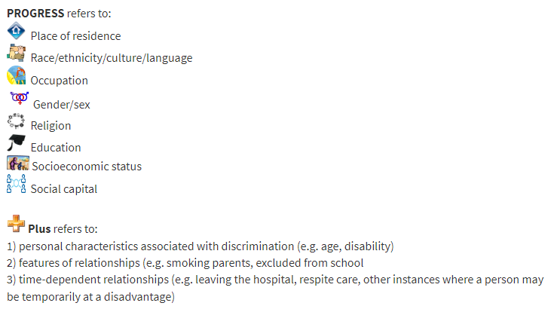
Diversity in the LEAPP context
PROGRESS-PLUS acronym
Consumer Panel selection criteria
Lived experience
Pregnant within the last five years (ideally)
Variety of pregnancy and postnatal journeys
Reflects Australian population
Aboriginal and Torres Strait Islander peoples
Recent migrants and refugees
LGBTQI+
Geographic diversity (metro/regional + States/Territories)
Live on a low income
Under 25 years of age
Consumer representative experience
Very experienced reps, through to inexperienced
Some people with experience contributing to guidelines
Most with connections with other consumers (formal or informal, e.g. Facebook groups)
Source: Cochrane Equity Methods Group
https://methods.cochrane.org/equity/projects/evidence-equity/progress-plus
Notes:
We thought very carefully about what diversity meant in the context of the pregnancy and postnatal care guidelines.
We wanted a diversity of lived experiences of pregnancy and a diversity of experience as a consumer rep, including people who were inexperienced as health consumer reps and those who were highly experienced. We wanted everyone to be connected to other consumers, but that could be formally through the membership of consumer groups, or informally, through social media groups.
We used the PROGRESS-PLUS mnemonic to think though the most important social and cultural factors we wanted to include.
The final panel Consumer Panel includes 16 women and people from around Australia with recent experience of pregnancy, and includes people living in regional areas, First Nations people, people from migrant and refugee backgrounds, LGBTIQA+ people, people living on a low income and people with experience of being a young mum. Four members were appointed as co-or deputy co-chairs.

Slide 11
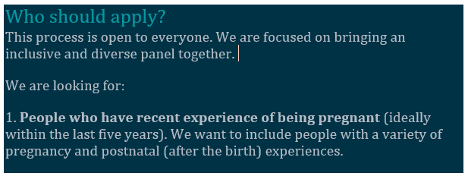
Design and recruitment
Co-designed consumer engagement model, draft terms or reference and recruitment process with Maternity Consumer Network
Inclusive, accessible application process – online form
Recruitment selection panel with 1 LEAPP staff + 2 consumers
Interviewed shortlist
101 applications received
Notes:
We worked with Alecia Staines of the Maternity Consumer Network and Michelle King, who was the co-chair of our COVID-19 living guidelines consumer panel to co-design how consumers should be involved in the LEAPP guidelines program, and then co-designed the draft terms of reference for the consumer panel, and the recruitment and application process.
Alecia pushed us to include some people who had less experience as a consumer rep, so that we could hopefully get a better mix of demographic characteristics, and to include people with very recent lived experience of pregnancy.
We designed an online form which asked people to tell us a bit about themselves and the experience they could bring to the committee, including whether they wanted to nominate for a chair or deputy co-chair role.
Alecia, Michelle and Annie all read the applications individually and rated them, then met multiple times to discuss and agree on the shortlist.
Shortlisted candidates attended a brief interview (with Annie and either Alecia or Michelle) over Zoom, before being appointed.

Slide 12
- Lived experience of how to recruit - Personal approaches - had completed consumer rep training, had provided consumer rep to us previously, or I knew of them - Trusted membership organisations - “influencers” on socials
How we recruited

Slide 13
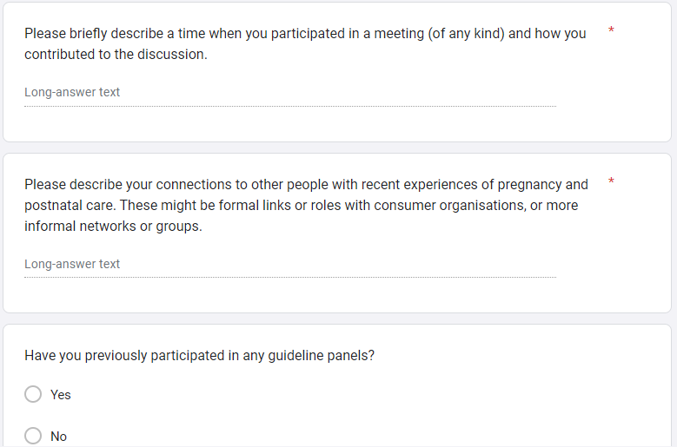
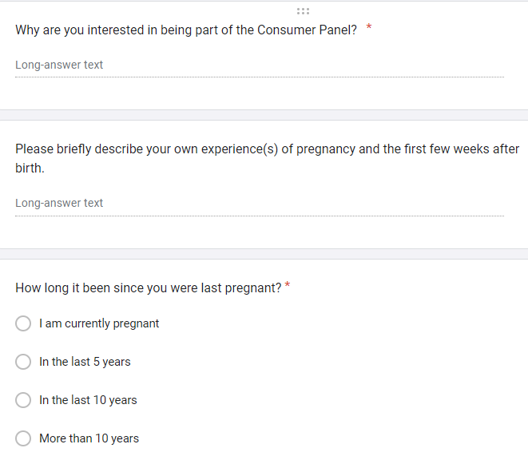
Application form – sample questions

Slide 14
Making an inclusive and impactful experience
Careful recruitment of experienced, inclusive consumer chairs
Offered peer mentoring
Devised a group agreement
Focus on plain language and non-patronizing explanations
Dedicated staff member to support the panel
Seek and respond to feedback about their experience
Sensitive topic check
Paid honorarium
Notes:
Careful recruitment of experienced, inclusive consumer chairs
1 x lead chair during meetings, with others monitoring the chat, privately messaging quieter members
Provide advice to LEAPP staff about all aspects of meetings and related activities (e.g. grant)
We offered peer mentoring at the outset, open to anyone but specifically targeting people who had no experience at a health consumer representative.
How to be a consumer representative
Mentoring was offered via Chairs and Maternity Consumer Network. Several less experienced members took this up
Devised a group agreement at the outset which includes practical information about, we flag sensitive topics prior to meetings and invite input via email or phone call after the meeting, permission to step out of meetings or take a break from attendance.
Honorarium reflects the role ($AUD 200 per meeting, with more for chairs)
We seek and respond to feedback. We started with an anonymous online survey and have now moved onto a formal process evaluation of LEAPP that covers the consumer panel. Feedback received to date has resulted in better feedback loop of how Consumer Panel’s input changed the recommendation and the chairs setting up a WhatsApp group.

Slide 15
Additions over time…
Relationship building
WhatsApp group for panel members to communicate informally between meetings
Added ‘what’s your news?’ agenda item
Encourage input from quieter members during meetings
Post-meeting check ins with quieter members

Slide 16
How consumers shape the recommendations
Clearer guidance (normal situation vs emergency)
More practical advice
New guidance (information provision)
Notes:
From the process evaluation:
Clinical panel and LEAPP team members felt that the consumer panel was having a positive impact on the language used throughout the guideline, encouraging/challenging clinicians and researchers to look at and question the evidence/language with a different lens.
Consumer Panel Perception of their impact: improved understandability of the guidelines, diversity and inclusion of the perspectives of lived experience; language that is more respectful of women and their diverse experiences.

Slide 17
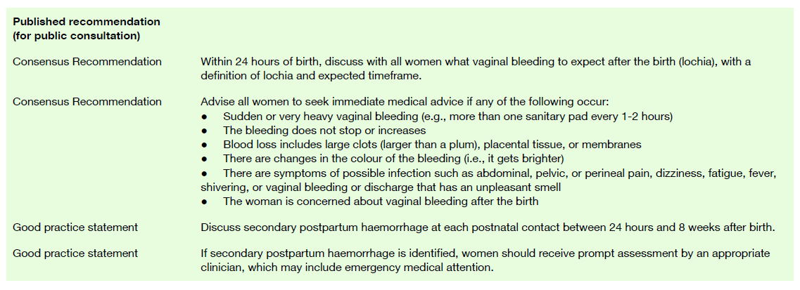
Consumer Panel changes carried through

Slide 18
How consumers are finding it
To what extent… | M +/- SD (N = 10)
Do you believe that your ideas are heard during the engagement process? | 5.40 (1.36)
Do you believe the LEAPP team takes your contributions to the engagement process seriously? | 6.60 (0.66)
Do you believe that your input will influence final decisions that underlie the engagement process? | 5.20 (1.47)
Are you able to clearly express your viewpoints? | 6.10 (1.14)
Do all participants have equal opportunity to participate in discussions? | 5.80 (1.25)
Is information made available to you either prior or during the engagement process so as to participate knowledgeably? | 6.30 (0.90)
“What is unique about the LEAPP model is that there isn't just one person tasked with advocating for consumer involvement, it's an entire team. At all levels of the hierarchy, the consumer voice is valued and staff make an effort to engage us with respect.”
Emma Preece Boyd, Deputy Co-Chair, Consumer Panel
PEET 6 – Moore 2022. J Clin Epi

Slide 19
How LEAPP team / clinicians are finding it
Evidence team, clinical experts, steering group members Satisfaction with engagement of consumers Extremely satisfied Somewhat satisfied Neither satisfied or dissatisfied Somewhat dissatisfied Extremely dissatisfied | N = 51 30 (59%) 12 (24%) 9 (18%) 0 (0%) 0 (0%)
‘It can be really uncomfortable when your clinical expertise is challenged by the lived experience of a consumer. I have learned to sit with this discomfort and genuinely listen to consumers. Not only has this made the guidelines more robust but it has made me a better clinician.’
Dr Nisha Khot, Obstetrician and Gynaecologist, LEAPP Clinical Fellow
‘To have recommendations that are consumer co-designed and approved makes such a difference to the development of guidelines that tangibly affect clinical care and outcomes. LEAPP is contemporary guideline development at its finest and such a privilege to be a part of.’
Assoc Prof Zoe Bradfield, Midwife, LEAPP Clinical Fellow

Slide 20
Take home messages
Have you got the resources/capacity to lower the barriers to participation for people from diverse backgrounds?
If yes, partner with experienced/connected consumers to plan and conduct recruitment
Relationships, relationships, relationships
For more information Anneliese.Synnot@monash.edu

