Slide 1
Equity, diversity and inclusion in evidence synthesis: how the PRO EDI tool can help
Shaun Treweek, Clarinda Cerejo and Ioanna Gkertso

Slide 2
What is the problem?
It is hard to be confident about a decision made without the benefit of evidence to support it. This is true for all of life’s decisions, be they about washing machines, what to have for dinner or healthcare.
What differs is what is considered acceptable evidence.

Slide 3
What is the problem?
For healthcare decisions, the evidence many decision-makers want is a high-quality systematic review. These reviews underpin guidelines that present evidence-informed recommendations affecting the care of millions of people.
These people are, obviously, not all the same. But does the review (and subsequent guidelines) acknowledge these differences?

Slide 4
Developed by a team
Project team: Shaun Treweek, Hanne Bruhn, Declan Devane, Jennifer Petkovic, Peter Tugwell, Vivian Welch
Advisory Group: Augustín Ciapponi, Clarinda Cerejo, Ioanna Gkertso, Ana Pizarro, KM Saif-Ur-Rahman, Jimmy Volmink
..plus ad hoc discussions with many others, including at Cochrane, Cochrane Equity and UK Evidence Synthesis Centres.

Slide 5
..and it’s been iterative..

Slide 6
Why does PRO EDI matter?
By not being transparent about who is represented within the evidence, a decision-maker may conclude that all will benefit, when in fact the evidence only speaks for a subset of those who could benefit.

Slide 7
What does this mean for patients?
Consider a systematic review on obesity

Slide 8
As a patient I ask: How does this review apply to me as a…
Woman
Person in her forties
Female
Brown Asian
Heterosexual
person
Person with comorbidities
Indian living in India
Person with my level of education
Person in my economic bracket
Person living in a Mumbai

Slide 9
Experience as a PPI Partner
Early Involvement:
Draft table of EDI characteristics
Flagged key terms in discussion (e.g. Ethnicity and Gender)
Followed Testing Updates:
Contributions to refining the characteristics table
Plain Language Summary feedback

Slide 10
Reflections from the Experience
Continuous Learning:
Insights into EDI and research methods
Reflection on key themes
Collaboration:
Supported through technical discussion
Valued the inclusive nature of the project

Slide 11
So what is PRO EDI?
Is based on PROGRESS-Plus.
Has been developed by an international team.
Gives concrete suggestions for what reviewers should extract from included trials.
We would like to give reviewers help on how to use the PRO EDI extracted data to inform the GRADE assessment.
Paper on PRO EDI is close to submission.

Slide 12
What does it look like?
Characteristic | Why?
Age | Widely collected
Sex | PROGRESS-Plus
Gender | PROGRESS-Plus
Ethnicity, race and ancestry | PROGRESS-Plus
Socioeconomic status | PROGRESS-Plus
Location (country or countries; rural or urban) | PROGRESS-Plus
Mandatory characteristics

Slide 13
What does it look like?
Characteristic | Why?
Sexual identity | PROGRESS-Plus
Level of education | PROGRESS-Plus
Disability | PROGRESS-Plus
Other factors relevant to the review | Potentially from PROGRESS-Plus
Extraction depends on review

Slide 14
PRO EDI
(short,
less guidance)

Slide 15
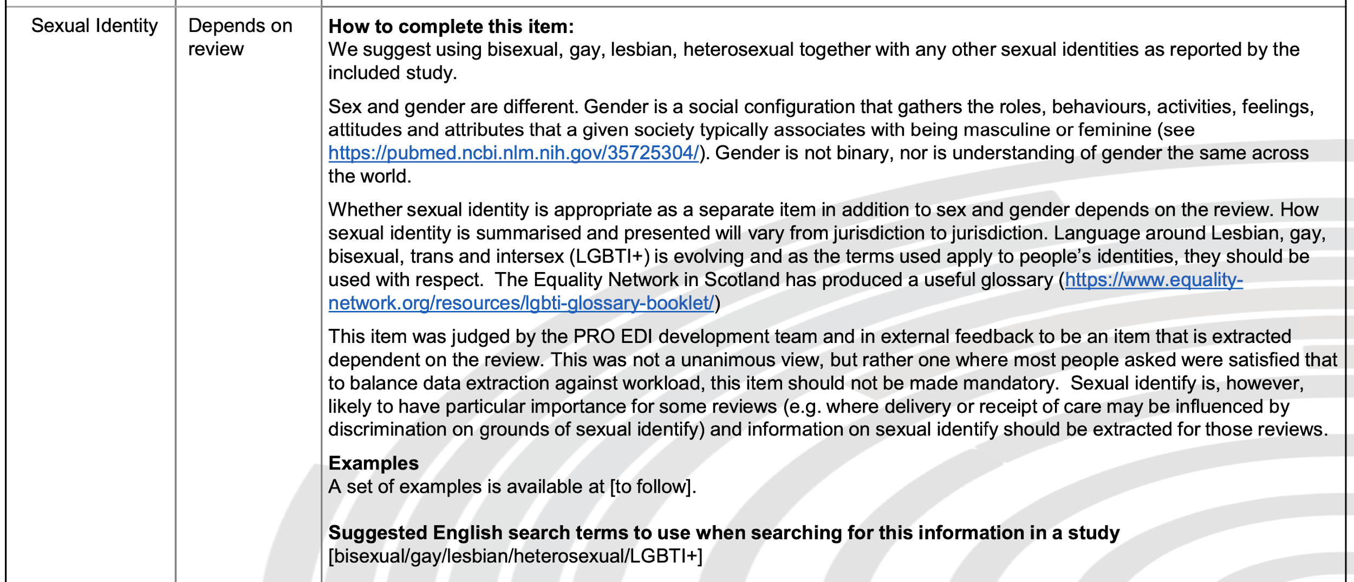

Slide 16
PRO EDI in Results
The review’s current result summary–
Multimedia education about clinical trials (DVD + booklet) vs standard educational booklet only
The evidence is very uncertain about the effect of multimedia education about clinical trials on recruitment compared to a standard booklet. RD = 4% (95% CI = -5% to 14%); GRADE: low (-2 levels: imprecision-single study; wide CI crossing RD=0).

Slide 17
PRO EDI in Results
With the PRO EDI assessment–
Equity information (see PRO EDI participant characteristics table)
This result and its GRADE assessment apply to older people, especially females, who are predominantly white with a range of incomes and education living in the USA. The GRADE assessment when applied to groups other than those mentioned will be below low because of indirectness.

Slide 18
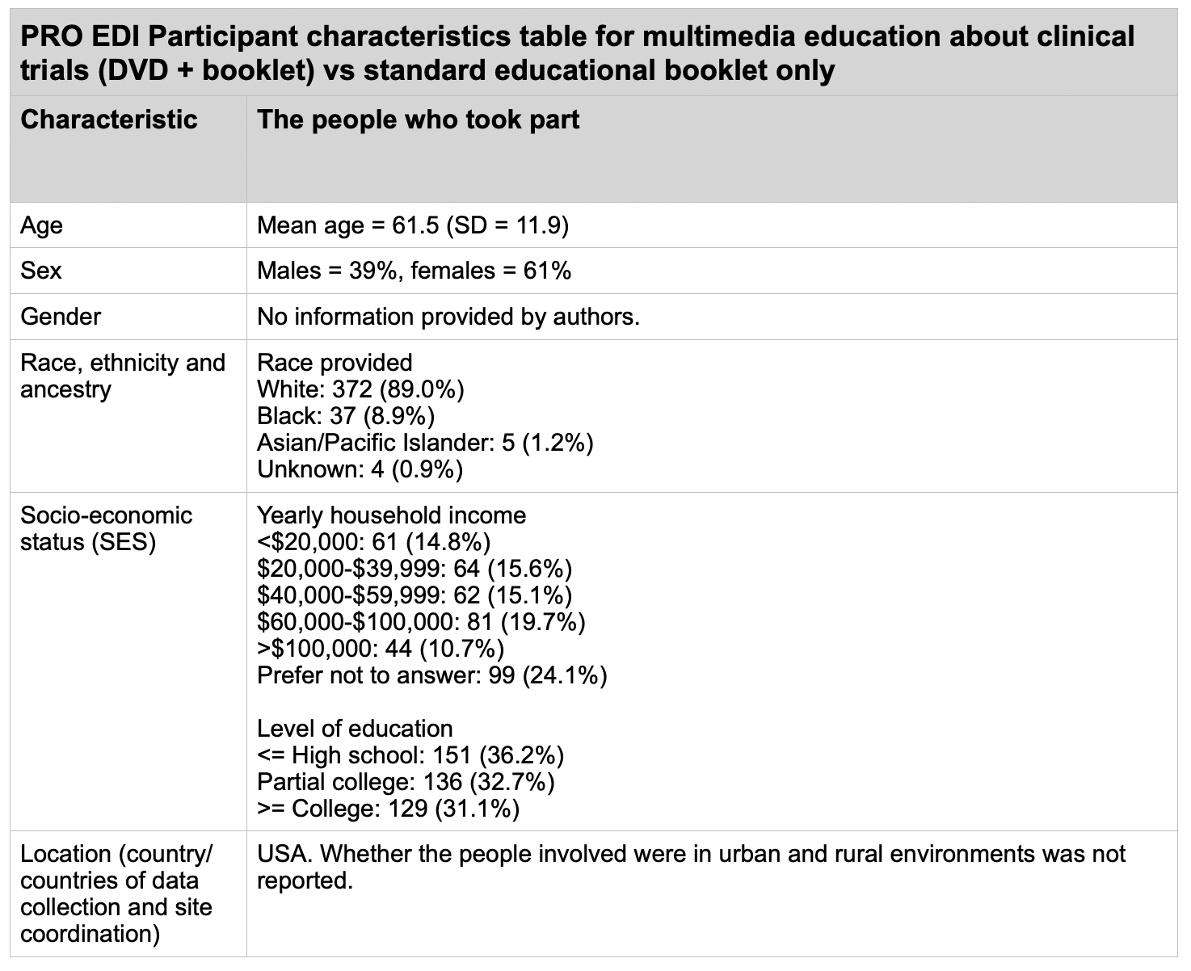
The PRO EDI table

Slide 19
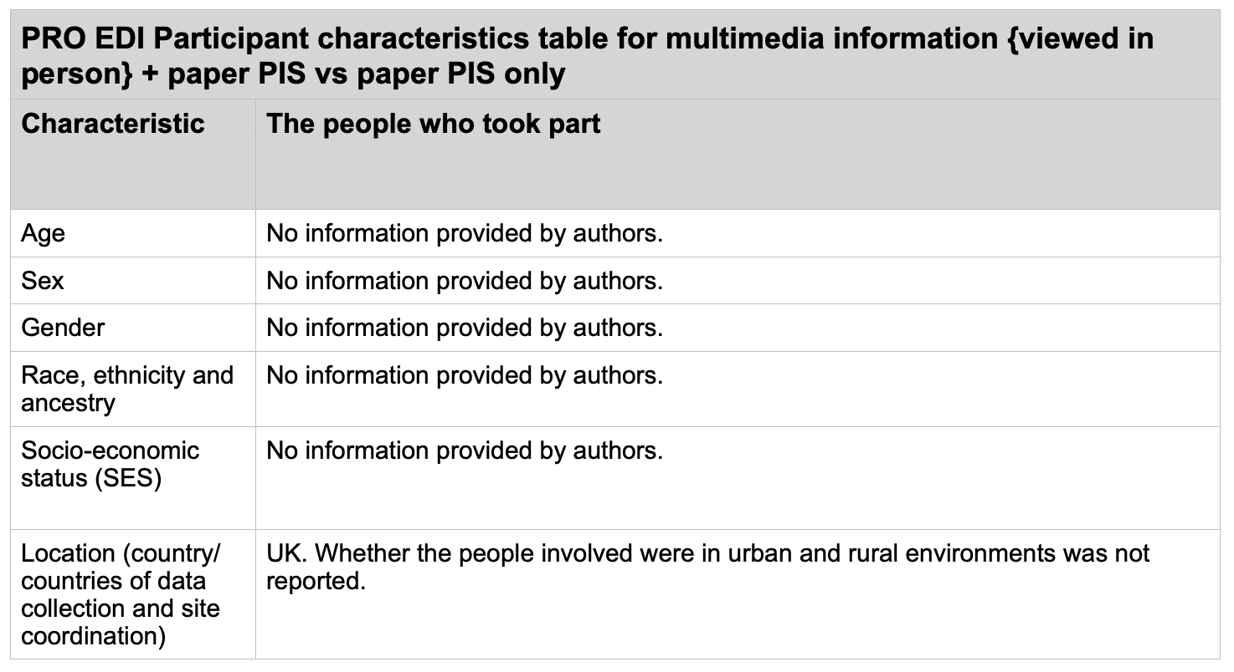
A common PRO EDI table..

Slide 20
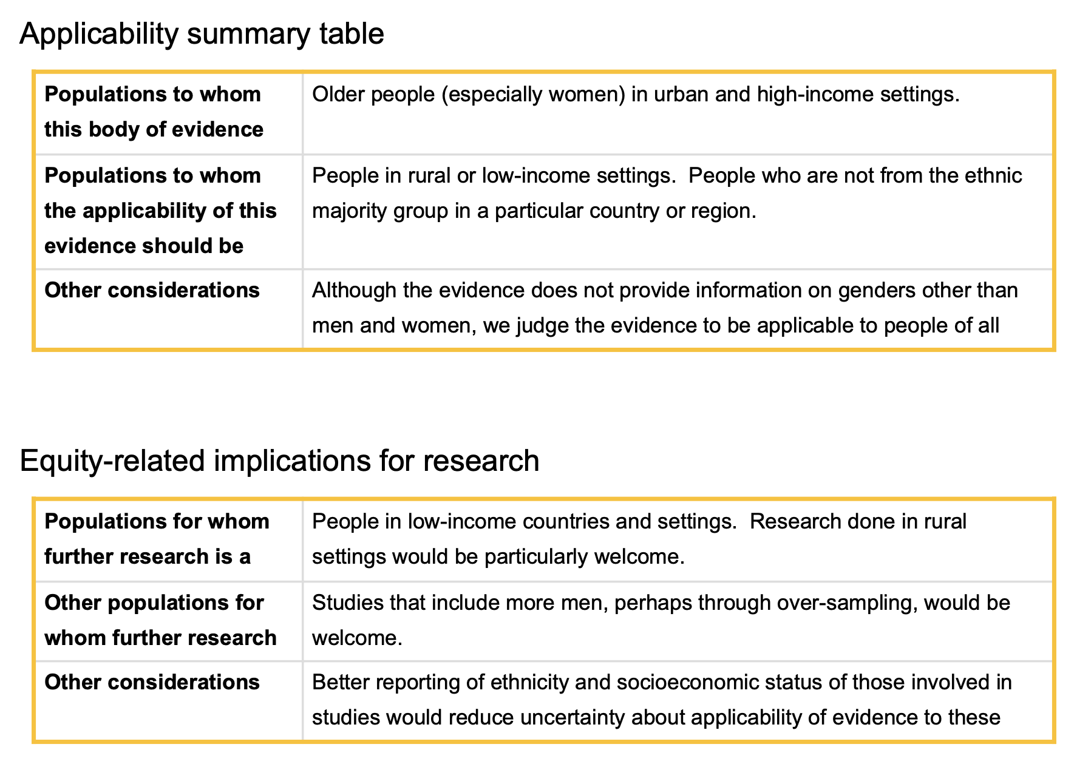
Applicability summary and implications for research

Slide 21
Summary
Systematic reviews need to be clear about who is represented in the body of evidence presented within them.
PRO EDI can help (we think), especially as it gives a clear steer as to what participant characteristics to extract.
We’re working on a standard method of Results presentation and interpretation.

Slide 22
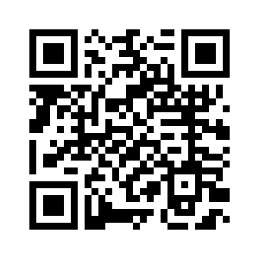
PRO EDI
More information on PRO EDI, including the full guidance version, is available at:
https://www.trialforge.org/trial-diversity/pro-edi/

